Slide 1
Food Inspection App
Team 4
Omar Abubakar, Brittany Johnson, Edmund Kargbo, Segen Tirfe, Avkash Chandra, Priyanshu Gupta

Slide 2

Prince George’s Food Inspection App
The information service we want to invent is a public health application to help and information the community about their food inspection ratings around the Prince George’s County area.

Slide 3

Facts and Figures 1
Facts and figures:
“A foodborne outbreak can cost a restaurant up to $100,000 in medical charges, lost wages, and lawyer fees.” (Tarca & Murphy, 2014, p. 1)*
“[Violations] can result in a 30% reduction in sales.” (Grover & Dausch, 2000, as cited in Tarca & Murphy, 2014, p. 1)*
* Tarca, S., & Murphy, K. (2014). Food safety inspections and storefront grade posting: The case of NYC and LA. International CHRIE. https://doi.org/10.4135/9781529710588

Slide 4
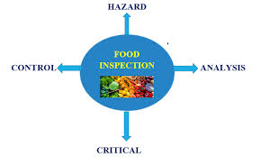
Information Need
Needs:
Prince George’s County lacks easy access to detailed food information
Non-user friendly readable information
Lack of user accessibility
Desire for food transparency and quality
Educational gap regarding food inspection & public health

Slide 5

Information Need
Avoiding high risk restaurants and likelihood of foodborne illnesses.
Raising awareness providing educational resources
Boost food safety
Food Industries will be held accountable
Operational standards

Slide 6
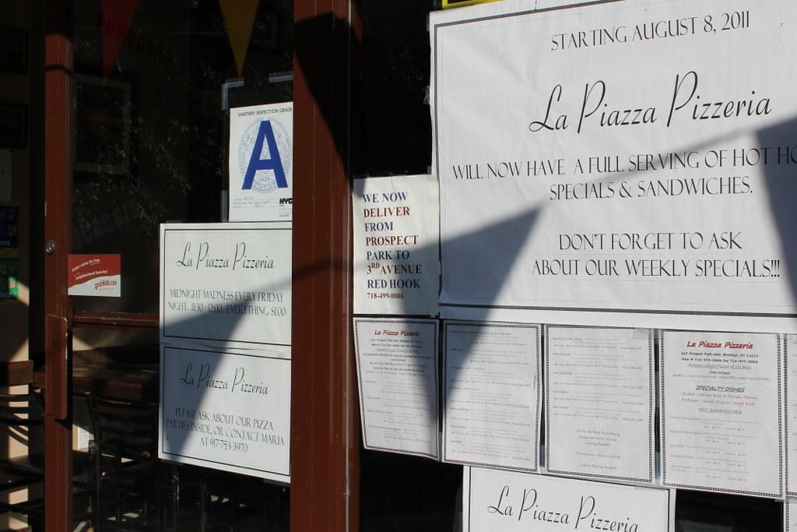
Facts and Figures 2
Facts and figures:
“In fact, a statistician found through observing Los Angeles sales tax reports that restaurants with an A letter grade would cause revenue increases of up to 6%, B grades would cause a revenue increase of 1–2%, and C grades would cause a revenue decrease at an average of 1%” (Jennings, 2008, as cited in Tarca & Murphy, 2014, p. 6)
* Tarca, S., & Murphy, K. (2014). Food safety inspections and storefront grade posting: The case of NYC and LA. International CHRIE. https://doi.org/10.4135/9781529710588

Slide 7
Functions & Utilities
The App setup would be:
“Who We Are?”
“Why this Matters?”
Browse Inspection by City
Search & Map & Trend
Resources

Slide 8
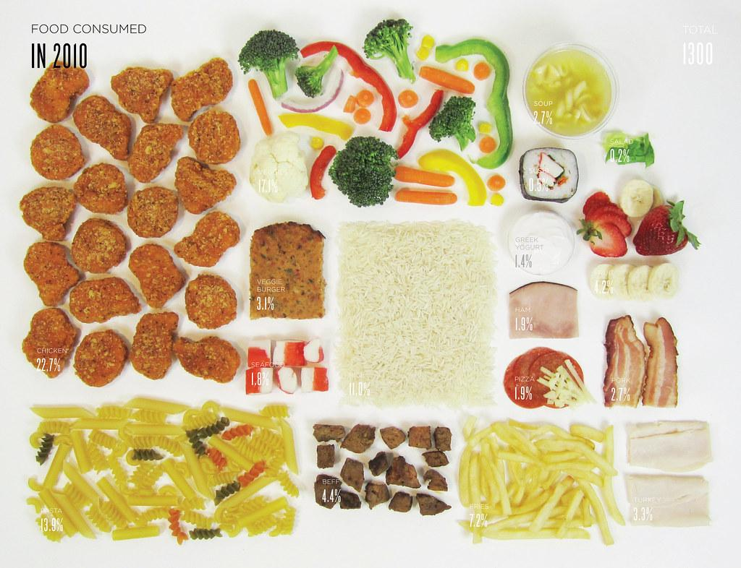
Facts and Figures 3
Facts and figures:
“Data visualization has been used as an important tool to gain insights into healthcare data sets, which are typically multivariate, discrete, and at different granularity levels.” (Sopan et al., 2012, p. 224)*
“While designing visual analytics tools for healthcare data, it is crucial to maintain simplicity as the targeted users need not have technical expertise.” (Sopan et al., 2012, p. 224)*
* Sopan, A., Noh, A. S.-I., Karol, S., Rosenfeld, P., Lee, G., & Shneiderman, B. (2012). Community Health Map: A geospatial and multivariate data visualization tool for public health datasets. Government Information Quarterly, 29(2), 223–234. https://doi.org/10.1016/j.giq.2011.10.002

Slide 9
Prototype

Slide 10
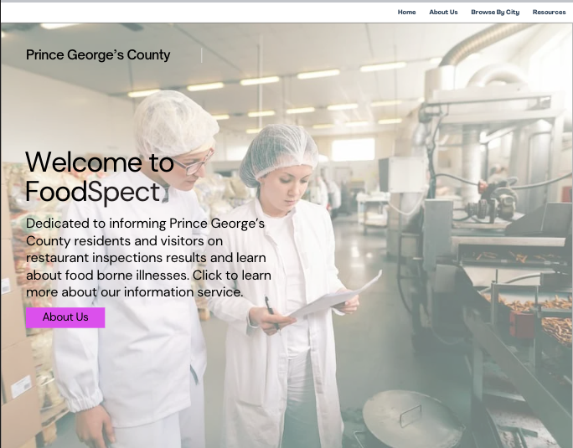
Home Page
Prototype

Slide 11
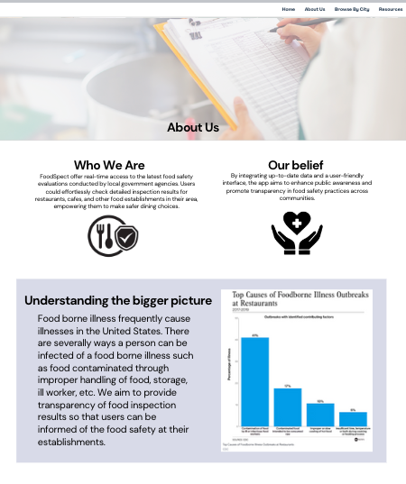
About Page

Slide 12
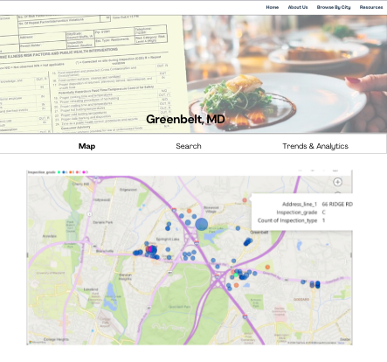
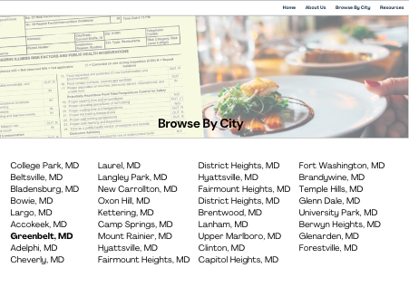
Browse by City Page
Map Page

Slide 13
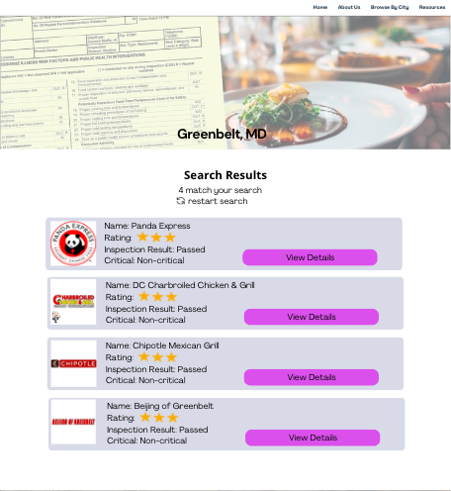
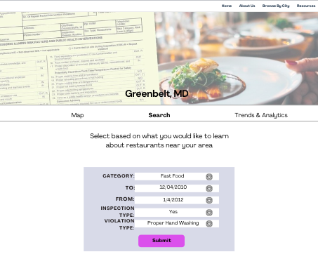
Search Filter Page
Search Result Page

Slide 14
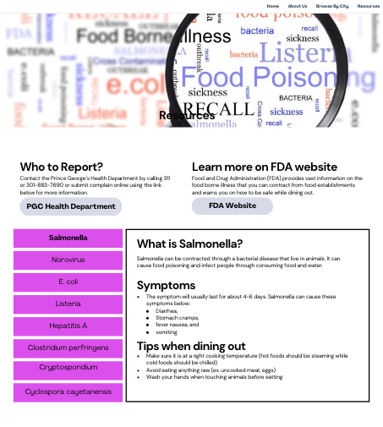
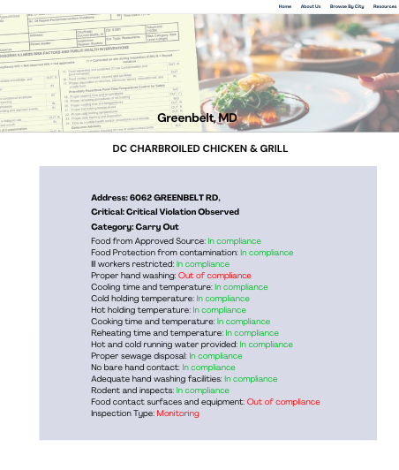
View Detail Button- Search Result
Resource Page

Slide 15
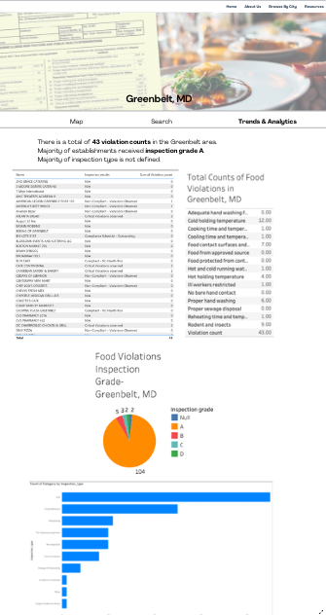
Trends & Analytics Page

Slide 16
User Personas

Slide 17
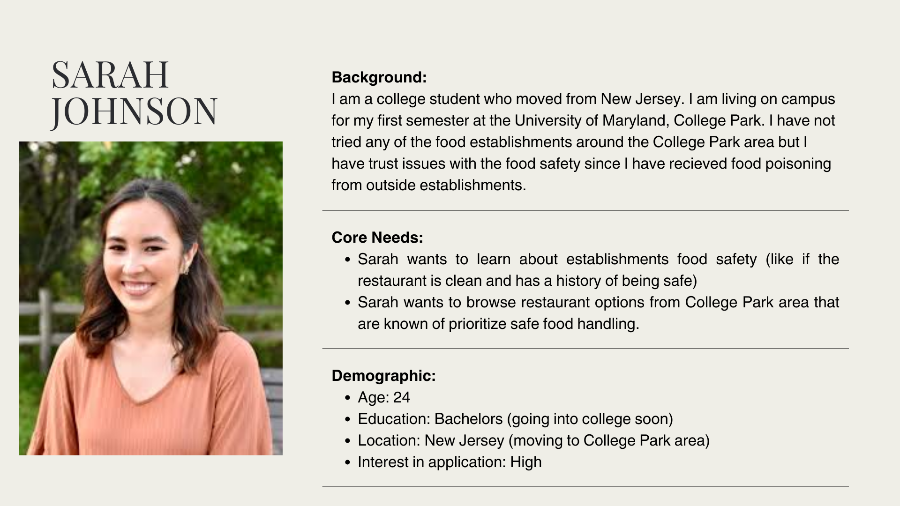

Slide 18
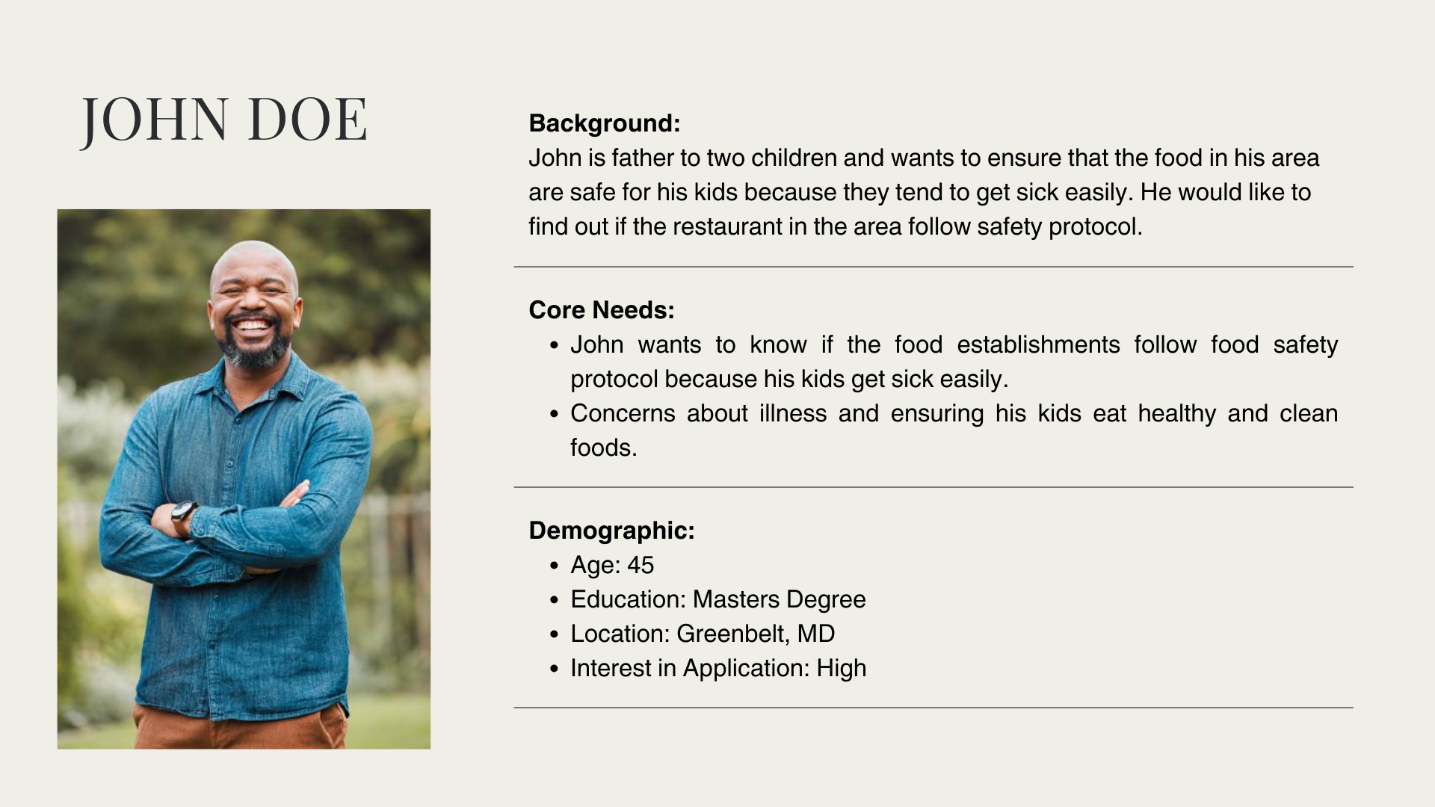

Slide 19
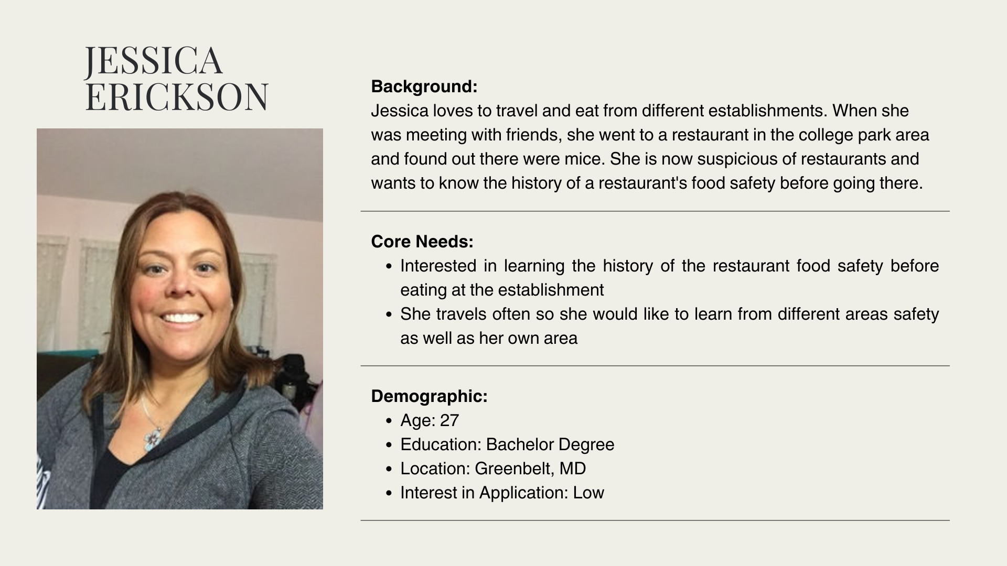

Slide 20
Data
& Visualizations

Slide 21
Compliance Data
We gained this data from the Prince George’s County website and used the compliance information to determine whether the businesses listed were in regulation based on these health codes. Once determined we were able to parse through the data and create our mockup prototype.

Slide 22
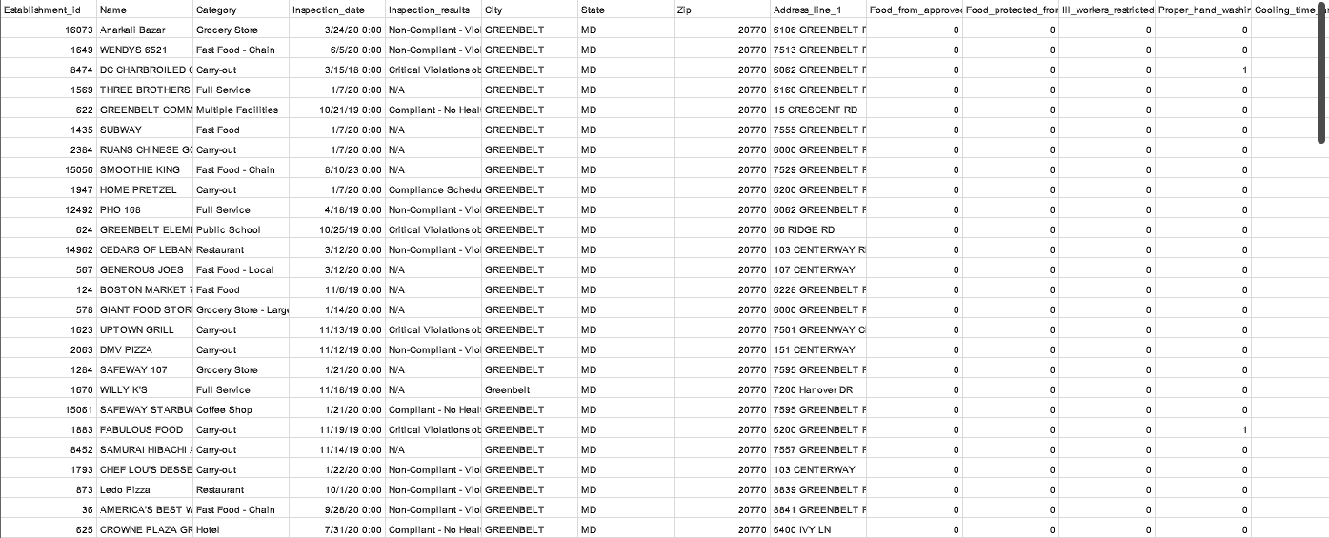
Example Data of User Browsing on Greenbelt, MD from city category

Slide 23
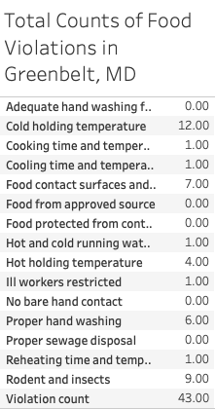
Visualizations detail view

Slide 24
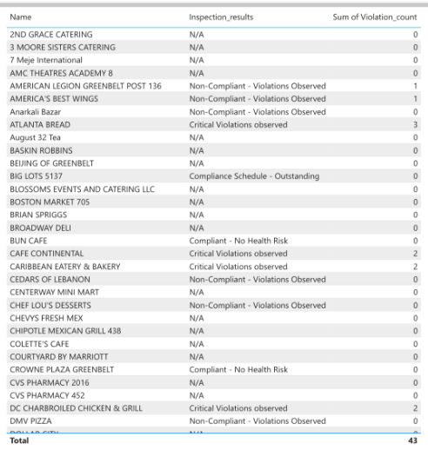
Visualizations detail view

Slide 25
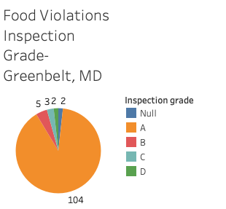
Visualizations detail view

Slide 26
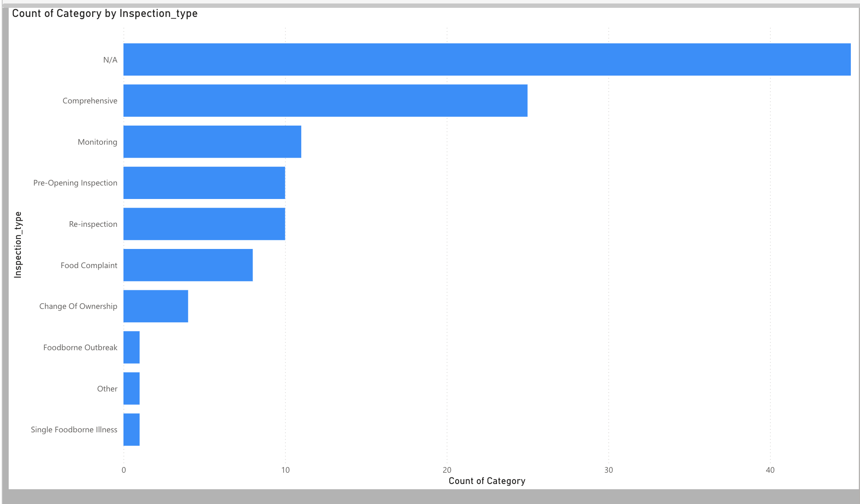
Visualizations detail view

Slide 27
Data Flow Diagram (DFD)

Slide 28
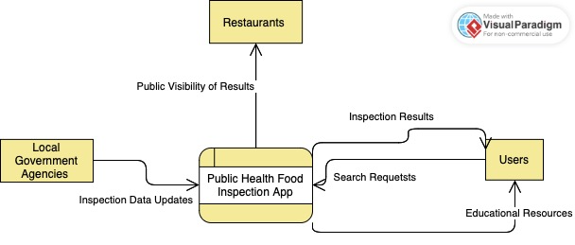
Context Diagram

Slide 29
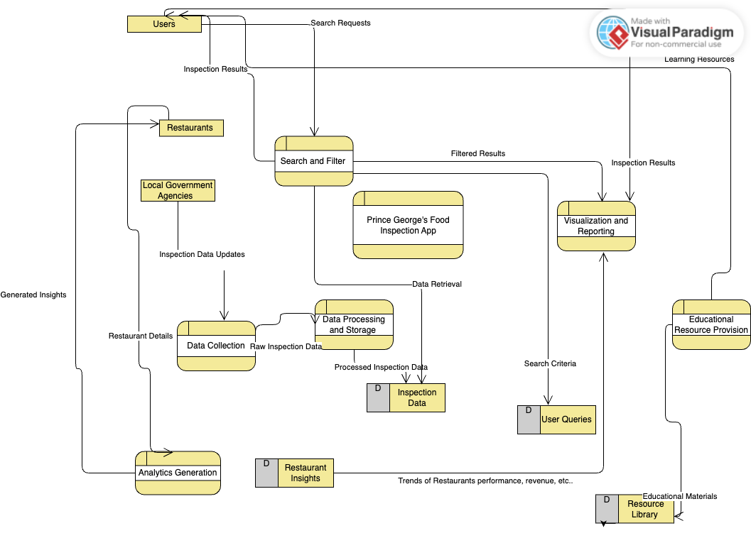
Level 0: Diagram

Slide 30
Entity Relationship Diagram (ERD)

Slide 31
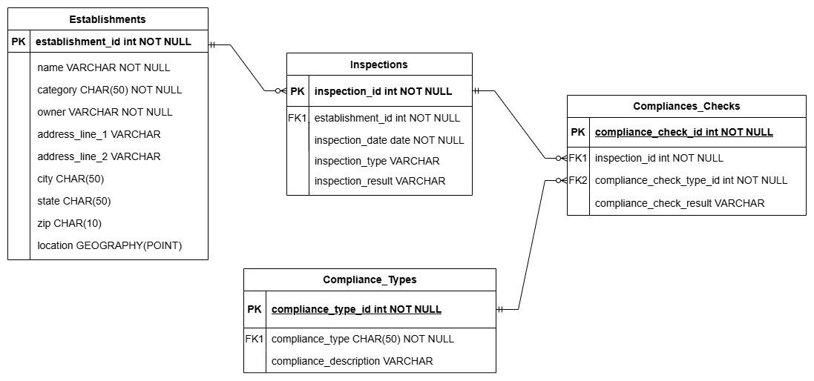

Slide 32
Thank You!

